Slide 1


Vinegar Foods
A leading Food Co. on your Finger tip.
Presented By:
Shabbir
Bilal
Arbab
Wajahat

Slide 2
Vinegar Foods
INTRODUCTION
Project Overview
Advantages
Presented by S.B.A.W

Slide 3
Vinegar Foods
Project Overview
Health
Time Safe
Project
Our project is basically about a Restaurant.
Hygienic.
Balance Diet.
Time Saving and just one click to buy Food.
Presented by S.B.A.W

Slide 4
Vinegar Foods
Advantages
Secret
Options
Meals
All meal plans available in one website.
Also available our Secret Recipes.
Complain ,Suggestion and many options available.
Presented by S.B.A.W

Slide 5
Vinegar Foods
RESEARCH
Research is creating new knowledge.
Presented by S.B.A.W

Slide 6
Vinegar Foods
Ideas From Websites
Pakistani Methods
Designing
Simplicity
Strategies
Presented by S.B.A.W

Slide 7


Vinegar Foods
Coding Ideas
Bootstrap
CSS
HTML
JavaScript
Presented by S.B.A.W

Slide 8
Vinegar Foods
DESIGN
Design is thinking made visible.
Presented by S.B.A.W

Slide 9
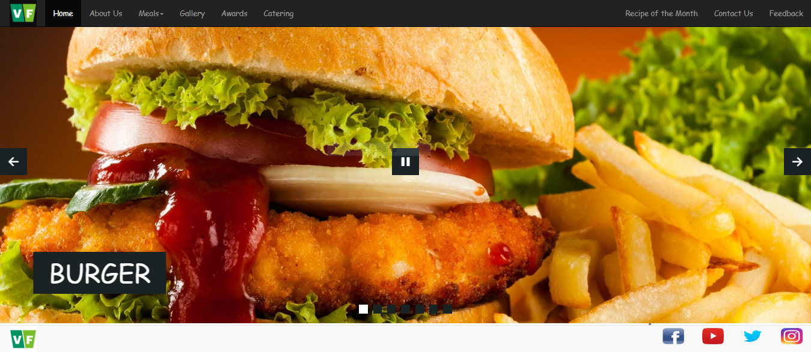
Vinegar Foods
Header
Presented by S.B.A.W

Slide 10
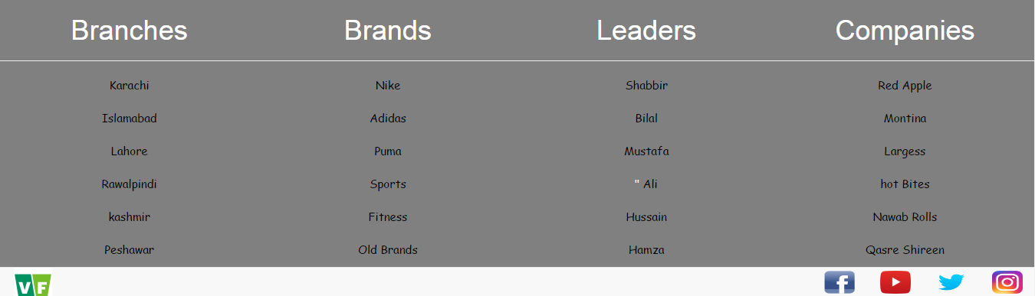
Vinegar Foods
Header
Presented by S.B.A.W

Slide 11
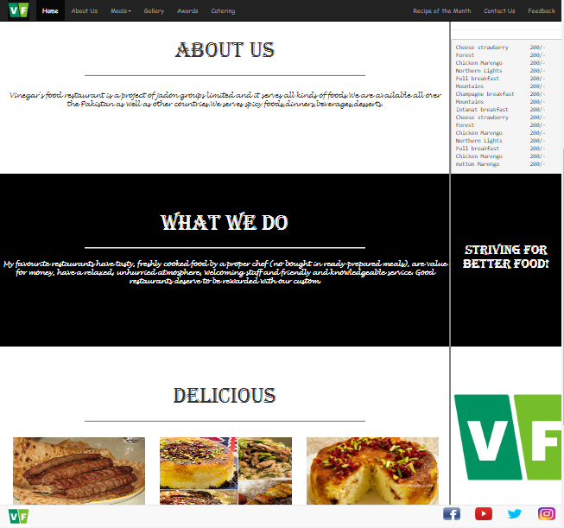
Vinegar Foods
Home
Presented by S.B.A.W

Slide 12
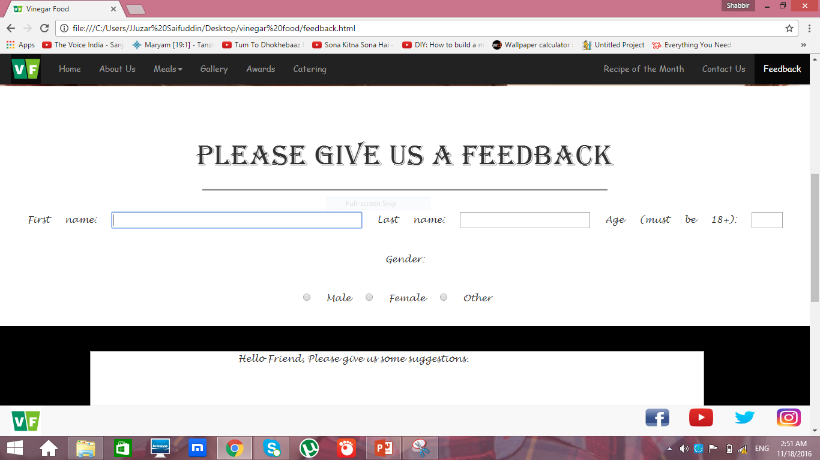
Vinegar Foods
Feedback
Presented by S.B.A.W

Slide 13
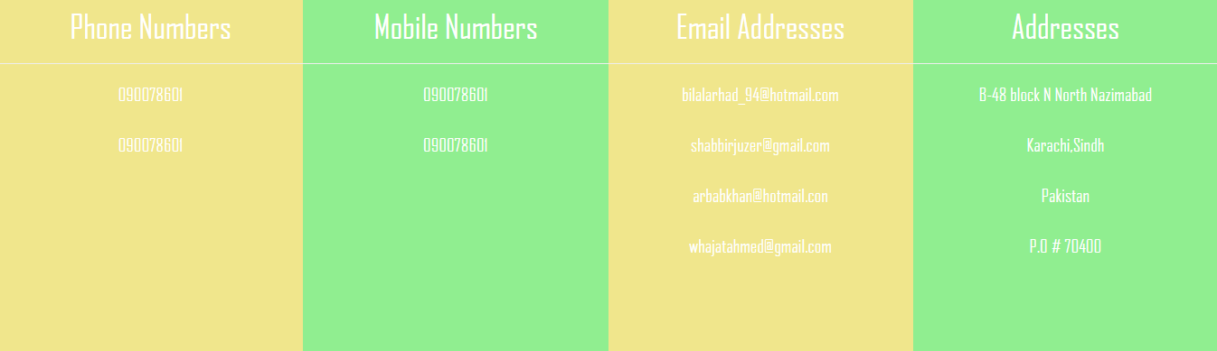
Vinegar Foods
Contact Us
Presented by S.B.A.W

Slide 14
Vinegar Foods
ANALYSIS
Truth suffers from too much Analysis.
Presented by S.B.A.W

Slide 15
Vinegar Foods
Days Consumed
Total Days: 11 Days
Project Submitted On Time.
Design documents Completed.
New recipes Available.
We Enjoyed the Project.
Presented by S.B.A.W

Slide 16
Vinegar Foods
Participated
Timeline
2-10-16
Started
11 Days
We Worked
13-10-16
Submitted
Presented by S.B.A.W

Slide 17
Vinegar Foods
THANK YOU
For listening to us.
Presented by S.B.A.W

